Slide 1
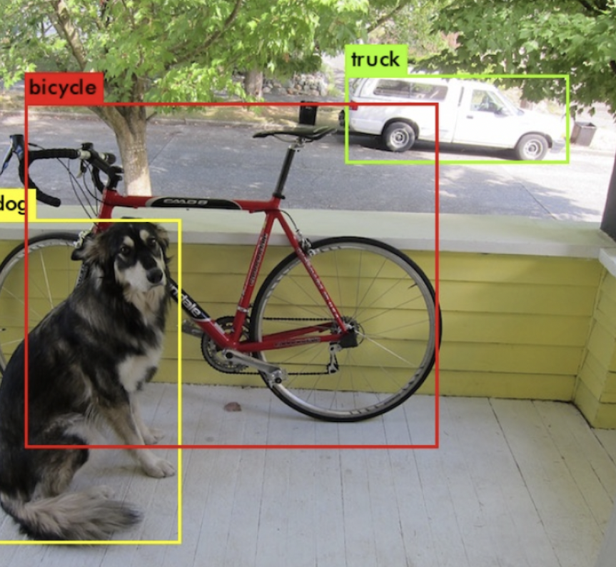
YOLO Algorithm for Object Detection
Neha
SCI Research Lab
neha@kent.edu

Slide 2

Contents
What is Object Detection
Two-stage object detection
What is YOLO?
How does YOLO work?
Intersection over Union (IoU)
Average Precision (AP)
YOLO, YOLOv2, YOLO9000, YOLOv3, YOLOv4+
Why the YOLO algorithm is important

Slide 3
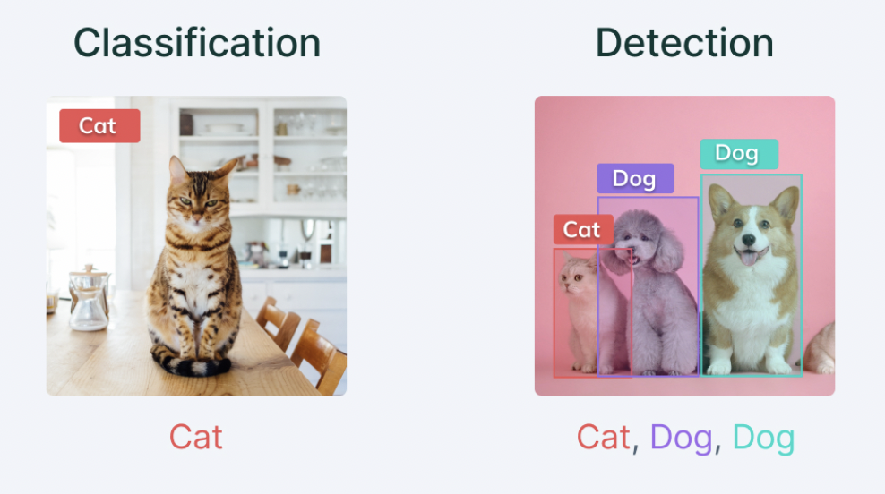
Object Detection
It is a phenomenon in computer vision that involves the detection of various objects (eg. people, cars, chairs, stones, buildings, and animals) in digital images or videos.
This phenomenon answers two basic questions:
What is the object?
This question seeks to identify the object in a specific image.
Where is it?
This question seeks to establish the exact location of the object within the image.

Slide 4
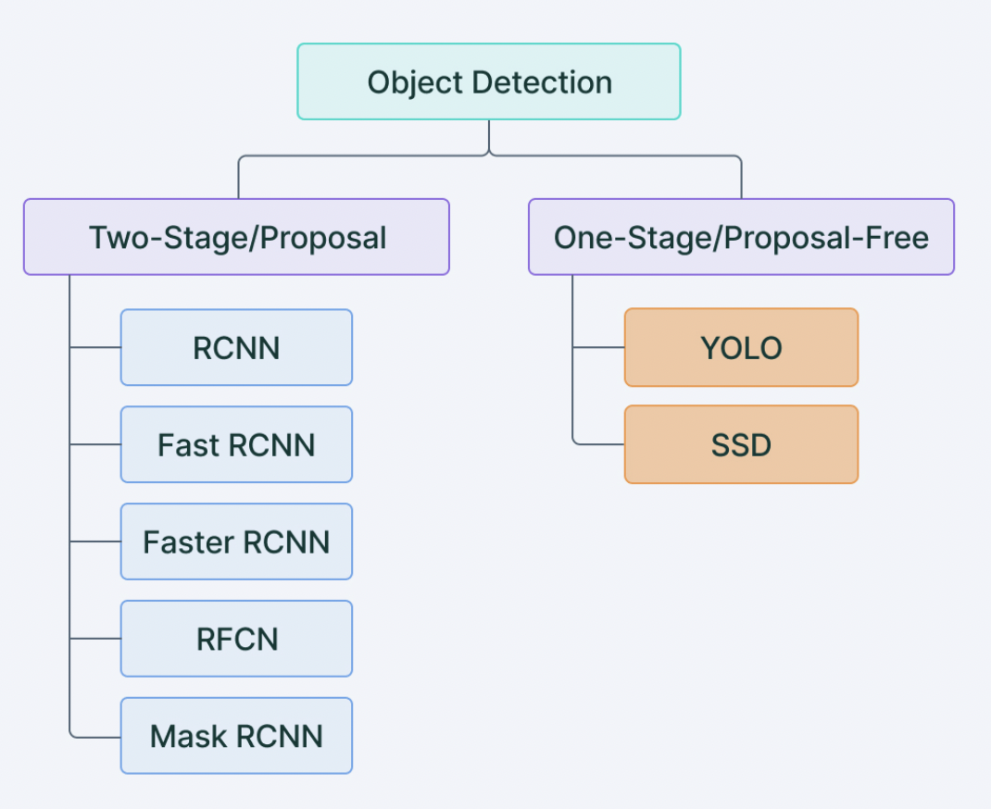
Two-stage object detection
Two-stage object detection refers to the use of algorithms that break down the object detection problem statement into the following two-stages:
Detecting possible object regions.
Classifying the image in those regions into object classes.

Slide 5
Popular two-step algorithms like Fast-RCNN and Faster-RCNN typically use a Region Proposal Network that proposes regions of interest that might contain objects.
The output from the RPN is then fed to a classifier that classifies the regions into classes.
While this gives accurate results in object detection with a high mean Average Precision (mAP), it results in multiple iterations taking place in the same image, thus slowing down the detection speed of the algorithm and preventing real-time detection.

Slide 6
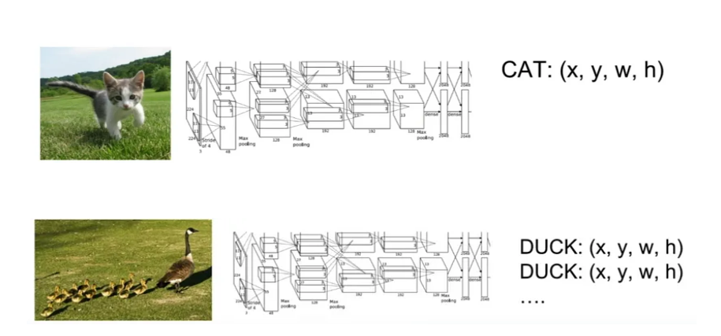
CNN :
many bounding boxes representing different objects of interest within the image & this is the major reason why you cannot proceed with this problem by building a standard convolutional network followed by a fully connected layer.
A naive approach to solve this problem would be to take different regions of interest from the image, and use a CNN to classify the presence of the object within that region. The problem with this approach is that the objects of interest might have different spatial locations within the image and different aspect ratios. Hence, you would have to select a huge number of regions and this could computationally blow up. Therefore, algorithms like R-CNN, YOLO etc have been developed to find these occurrences and find them fast.

Slide 7
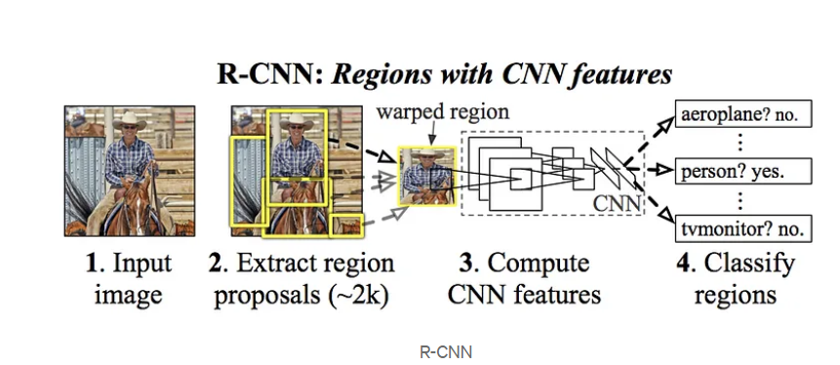
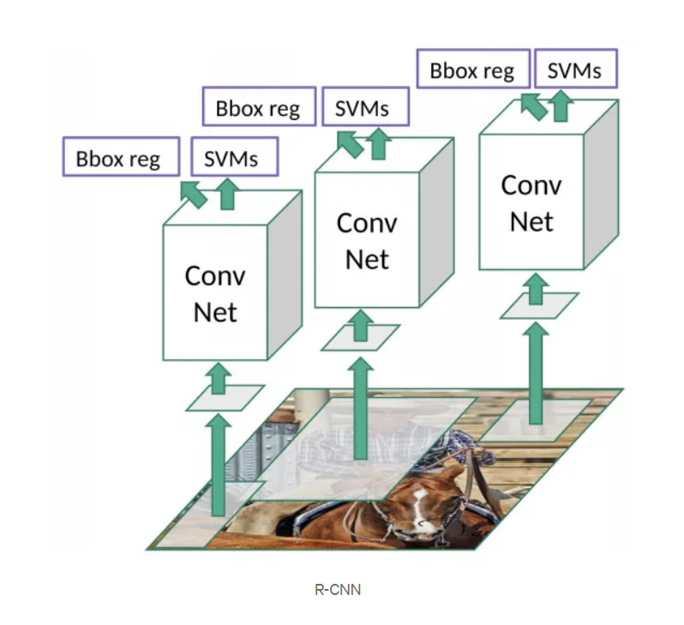
R-CNN:
proposed a method where we use selective search to extract just 2000 regions from the image and he called them region proposals. Therefore, now, instead of trying to classify a huge number of regions, you can just work with 2000 regions.
the offset values help in adjusting the bounding box of the region proposal to detect the precise object based on the requirement. Eg. if the human is detected and face detected only half in the sense, by using this offset values, we can adjust them
Problems with R-CNN
It still takes a huge amount of time to train the network as you would have to classify 2000 region proposals per image.
It cannot be implemented real time as it takes around 47 seconds for each test image.
The selective search algorithm is a fixed algorithm. Therefore, no learning is happening at that stage. This could lead to the generation of bad candidate region proposals.

Slide 8
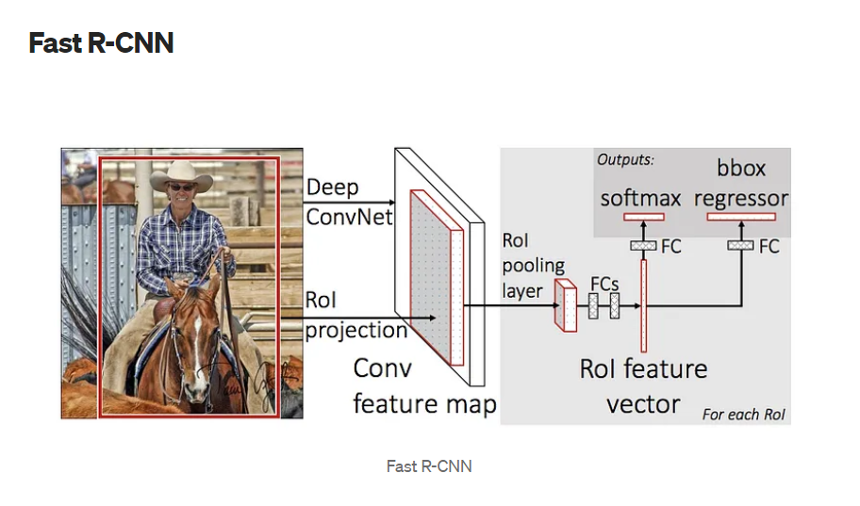
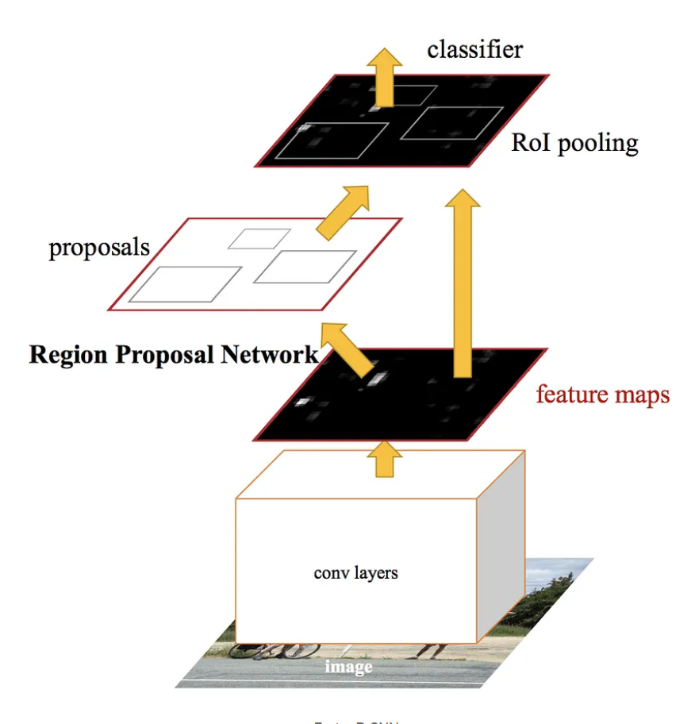
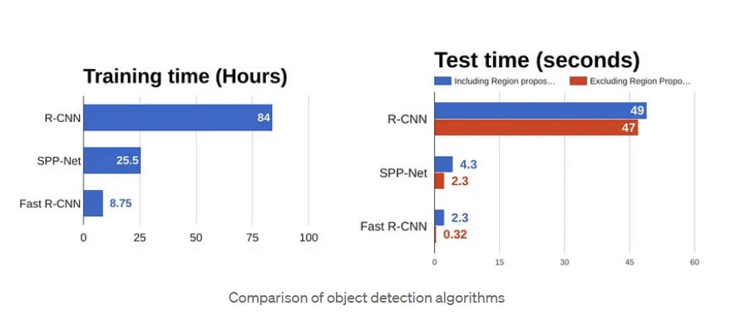
Faster R-CNN:
approach is similar to the R-CNN algorithm. But, instead of feeding the region proposals to the CNN, we feed the input image to the CNN to generate a convolutional feature map. From the convolutional feature map, we identify the region of proposals and warp them into squares and by using a RoI pooling layer we reshape them into a fixed size so that it can be fed into a fully connected layer.
The reason “Fast R-CNN” is faster than R-CNN is because you don’t have to feed 2000 region proposals to the convolutional neural network every time. Instead, the convolution operation is done only once per image and a feature map is generated from it.

Slide 9
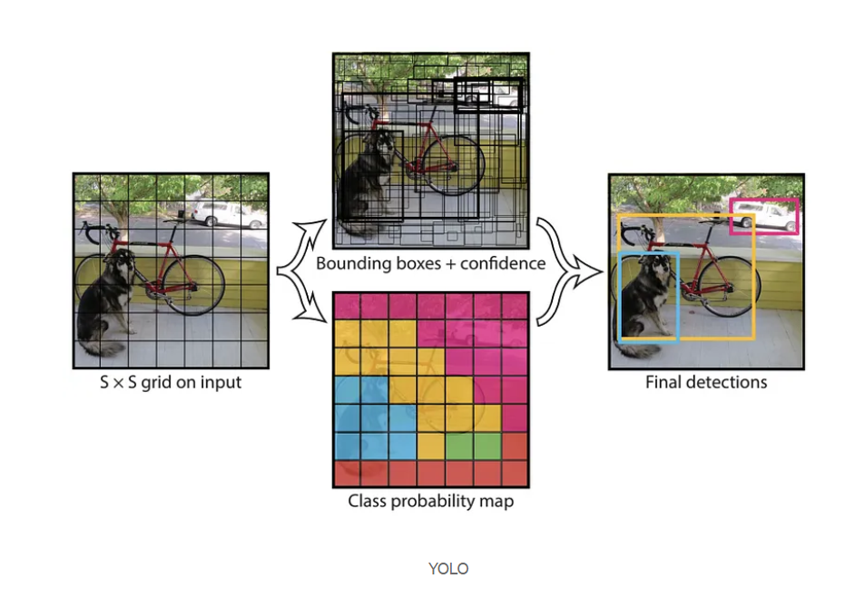
YOLO:
All of the previous object detection algorithms use regions to localize the object within the image. The network does not look at the complete image. Instead, parts of the image which have high probabilities of containing the object. YOLO or You Only Look Once is an object detection algorithm much different from the region based algorithms seen above. In YOLO a single convolutional network predicts the bounding boxes and the class probabilities for these boxes.
take an image and split it into an SxS grid, within each of the grid we take m bounding boxes. For each of the bounding box, the network outputs a class probability and offset values for the bounding box. The bounding boxes having the class probability above a threshold value is selected and used to locate the object within the image.
YOLO is orders of magnitude faster(45 frames per second) than other object detection algorithms. The limitation of YOLO algorithm is that it struggles with small objects within the image, for example it might have difficulties in detecting a flock of birds. This is due to the spatial constraints of the algorithm.

Slide 10
What is YOLO? You Only Look Once
YOLO is an algorithm proposed by by Redmond et. al in a research article published at the IEEE/CVF Conference on Computer Vision and Pattern Recognition (CVPR) as a conference paper, winning OpenCV People’s Choice Award.
In Comparison with other object detection algorithms, YOLO proposes the use of an end-to-end neural network that makes predictions of bounding boxes and class probabilities all at once.

Slide 11
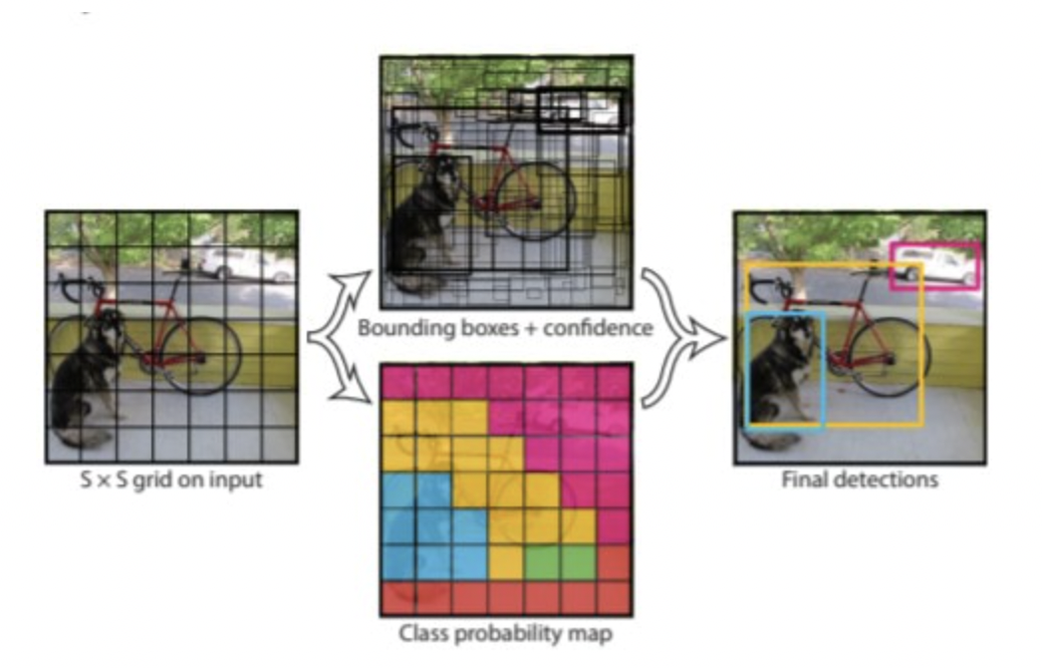
How does YOLO work?
The YOLO algorithm works by dividing the image into N grids, each having an equal dimensional region of SxS.
Each of these N grids is responsible for the detection and localization of the object it contains.
Correspondingly, these grids predict B bounding box coordinates relative to their cell coordinates, along with the object label and probability of the object being present in the cell.

Slide 12
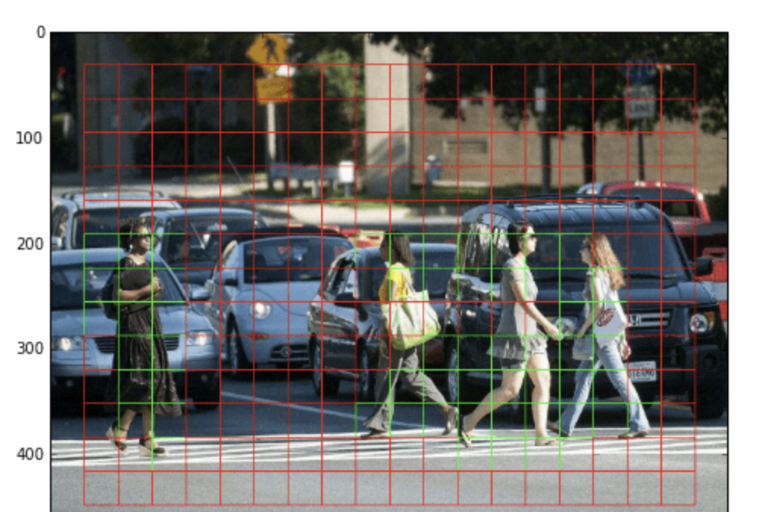
Residual blocks First, the image is divided into various grids. Each grid has a dimension of S x S. The following image shows how an input image is divided into grids. ImageSource: https://www.guidetomlandai.com/assets/img/computer_vision/grid.png

Slide 13
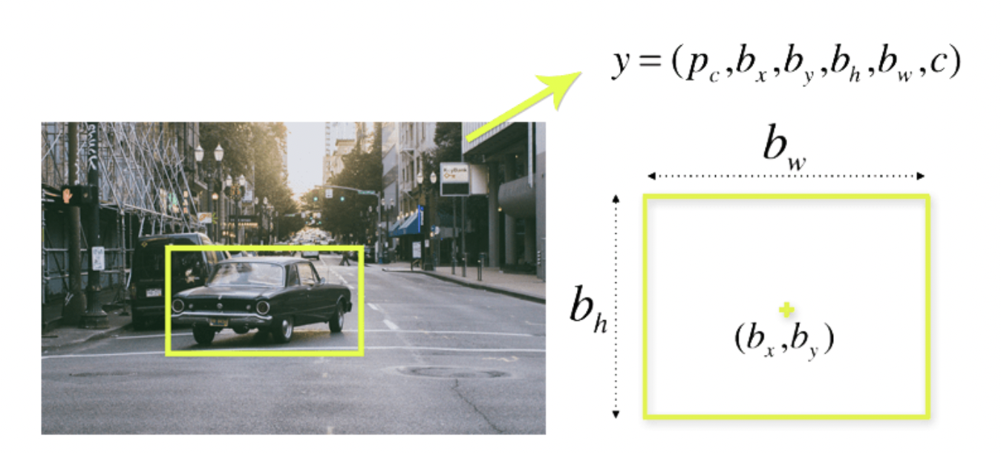
Bounding box regression
A bounding box is an outline that highlights an object in an image.
Every bounding box in the image consists of the following attributes:
Width (bw)
Height (bh)
Class (for example, person, car, traffic light, etc.)- This is represented by the letter c.
Bounding box center (bx,by)

Slide 14
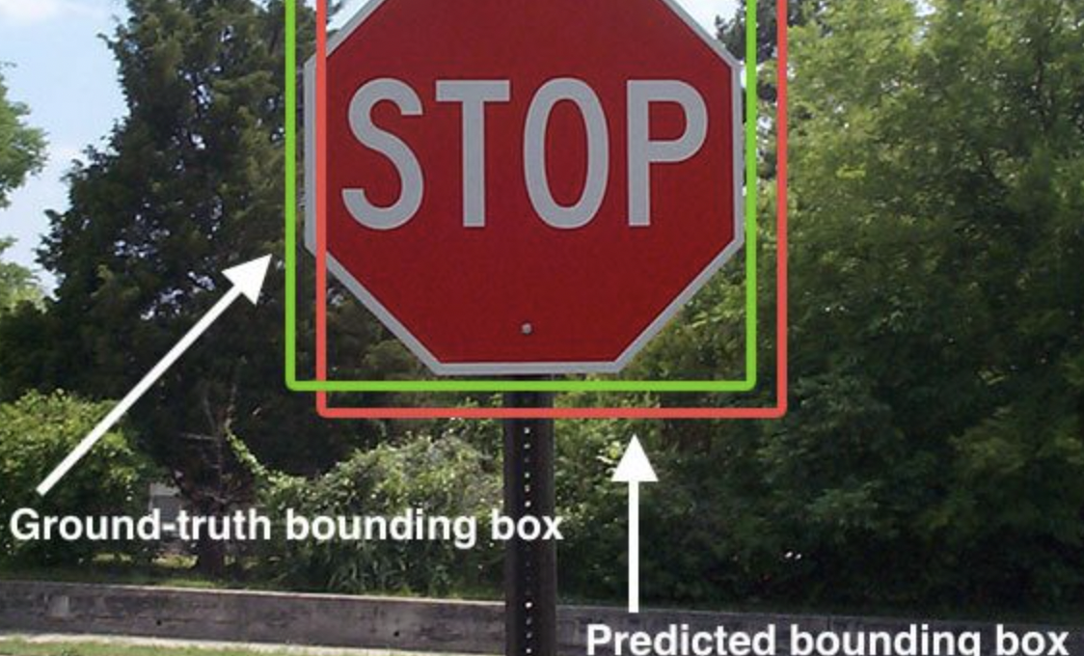
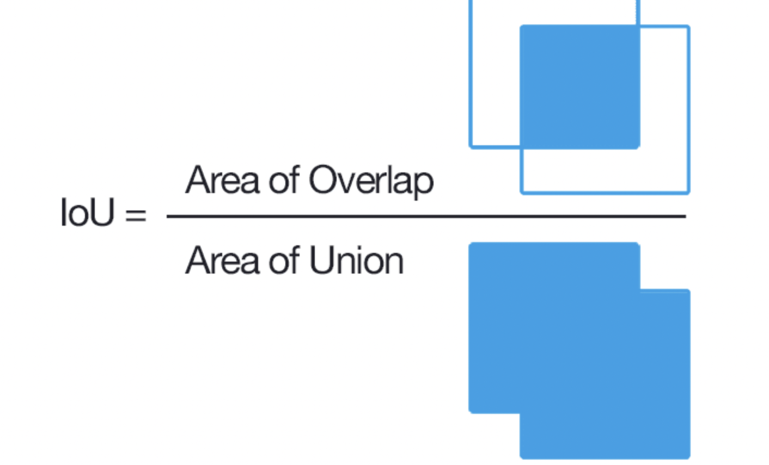
Intersection over Union
Intersection over Union is a popular metric to measure localization accuracy and calculate localization errors in object detection models.
To calculate the IoU with the predictions and the ground truth, we first take the intersecting area between the bounding boxes for a particular prediction and the ground truth bounding boxes of the same area. Following this, we calculate the total area covered by the two bounding boxes—also known as the Union.
The intersection divided by the Union, gives us the ratio of the overlap to the total area, providing a good estimate of how close the bounding box is to the original prediction.
Note: Localization error occurs when an object from the target category. is detected with a misaligned bounding box (0.1 <= overlap < 0.5).

Slide 15
IoU
Intersection over union ensures that the predicted bounding boxes are equal to the real boxes of the objects.
This phenomenon eliminates unnecessary bounding boxes that do not meet the characteristics of the objects (like height and width). The final detection will consist of unique bounding boxes that fit the objects perfectly.

Slide 16
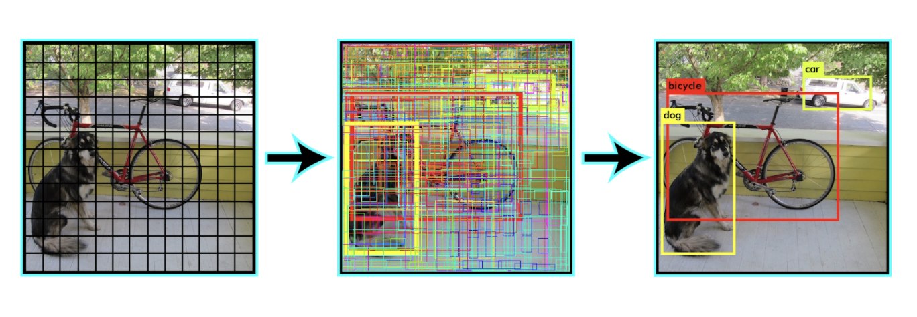
Other methods brings forth a lot of duplicate predictions due to multiple cells predicting the same object with different bounding box predictions. YOLO makes use of Non Maximal Suppression to deal with this issue.
In Non Maximal Suppression, YOLO suppresses all bounding boxes that have lower probability scores.
YOLO achieves this by first looking at the probability scores associated with each decision and taking the largest one. Following this, it suppresses the bounding boxes having the largest Intersection over Union with the current high probability bounding box.
This step is repeated till the final bounding boxes are obtained.

Slide 17
Average Precision (AP)
Average Precision is calculated as the area under a precision vs recall curve for a set of predictions.
Recall is calculated as the ratio of the total predictions made by the model under a class with a total of existing labels for the class.
On the other hand, Precision refers to the ratio of true positives with respect to the total predictions made by the model.
The area under the precision vs recall curve gives us the Average Precision per class for the model. The average of this value, taken over all classes, is termed as mean Average Precision (mAP).
Note: In object detection, precision and recall are not for class predictions, but for predictions of boundary boxes for measuring the decision performance.
An IoU value > 0.5. is taken as a positive prediction, while an IoU value < 0.5 is a negative prediction.

Slide 18
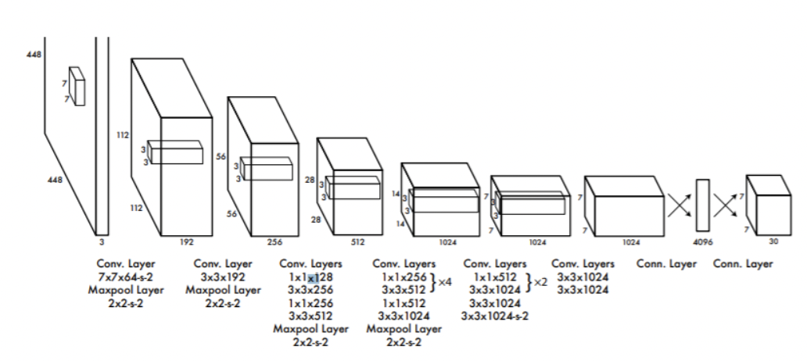
YOLO Architecture
Inspired by the GoogleNet architecture, The first YOLO architecture has a total of 24 convolutional layers with 2 fully connected layers at the end.

Slide 19
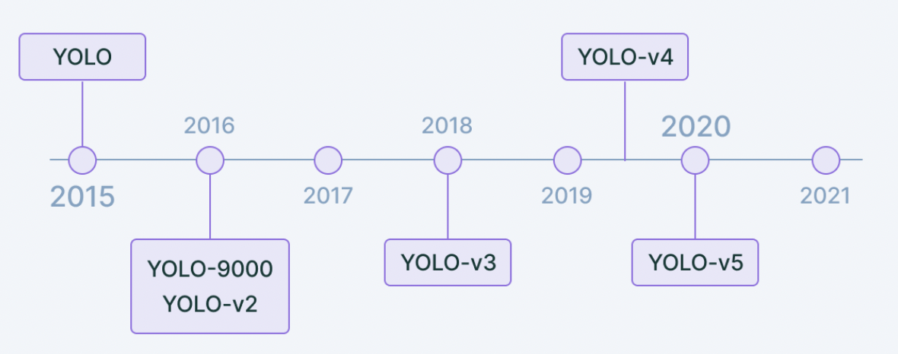
Yolo Timeline

Slide 20
The differences: YOLOv2, YOLO9000, YOLOv3, YOLOv4+
YOLOv2 | YOLO9000 | YOLOv3 | YOLOv4+
YOLOv2 detects even the smallest of objects in groups and the localization accuracy, Anchor boxes | An algorithm to detect more classes than COCO, capable of detecting more than 9000 classes. | YOLOv3 uses a much more complex DarkNet-53 as the model backbone. | Weighted Residual Connections, Cross Mini Batch Normalization
Increased mean Average Precision of the network by introducing batch normalization. | However, it provides a lower mean Average Precision as compared to YOLOv2 | A 106 layer neural network complete with residual blocks and up-sampling networks | YOLOv5 is an open-source project based on the YOLO model pre-trained on the COCO dataset

Slide 21
Importance of YOLO
YOLO algorithm is important because of the following reasons:
Speed: This algorithm improves the speed of detection because it can predict objects in real-time.
High accuracy: YOLO is a predictive technique that provides accurate results with minimal background errors.
Learning capabilities: The algorithm has excellent learning capabilities that enable it to learn the representations of objects and apply them in object detection.

